Slide 1

Evaluating models for Stock Price Forecasting
Rupali Shah

Slide 2
Table of Contents
Overview
Data Acquisition
Data Exploration
Models
ARIMA
LSTM
VAR
Results
Future Work

Slide 3
Overview
Stock prices of an Oil and Gas company, Chevron Corp. (CVX) are predicted using Time Series Forecasting.
Data is fitted to three different models to make predictions.

Slide 4
Data Acquisition
Daily stock data for Chevron Corporation (CVX) for 5 years is acquired from the Quandl API.
5-year Inflation Rate is downloaded from the FRED website as a CSV file.

Slide 5
Data Exploration
Stock Price
The Stock Price data from Quandl has 12 features and 1090 observations .
Inflation rate
The Inflation Rate dataset from FRED has 2 features and 1303 observations.
Target Variable
The Adj. Closing Price is considered as the Target variable as it reflects the stock’s value after accounting for any corporate actions.

Slide 6
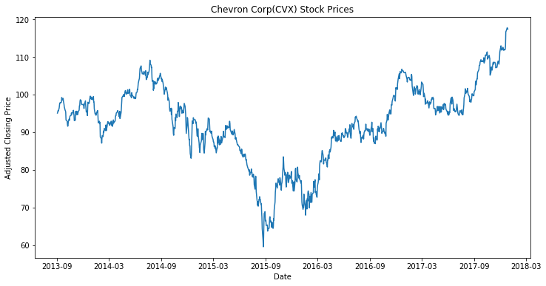
Chevron Adjusted Closing Price over a period of 5 years

Slide 7
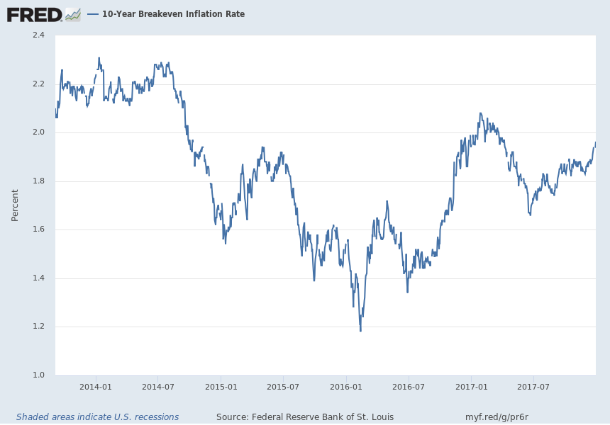
Inflation Rate over a period of 5 years

Slide 8
ARIMA model
https://github.com/RupaliShah/Springboard/blob/master/Capstone2/Stock%20Prediction%20with%20ARIMA%20.ipynb

Slide 9
What is ARIMA and Auto ARIMA?
ARIMA - Auto Regressive Integrated Moving Average.
Statistical method which needs a univariate series.
Characterized by three terms p,d,q
p – Auto Regressive, value determined by the PACF plot.
d – minimum number of differencing needed to make the series stationary.
q – Moving Average, determined by the ACF plot.
Auto ARIMA automatically selects the best combination of (p,d,q) that provides the least error based on the AIC and BIC values.

Slide 10
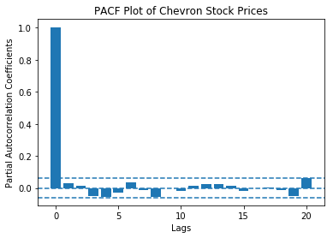
Partial Auto Correlation Plot
The PACF plot determines the Auto Regressive (AR) term (p).
AR refers to the past values for forecasting the next value.
Value of p = the lags that cross the significance limit in the PACF plot.
This plot shows that the value of p = 0.

Slide 11
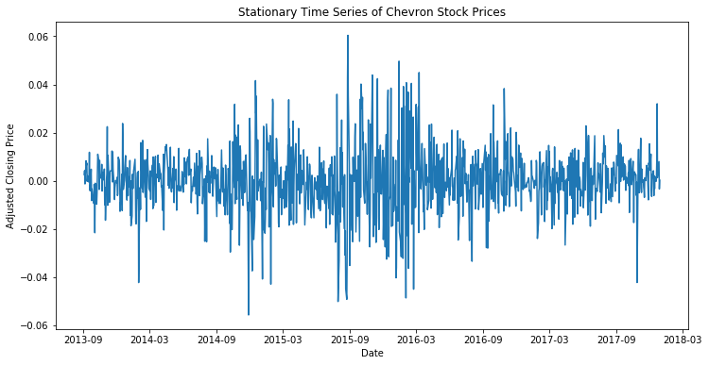
Stationary Series
Stationarity for a univariate series is checked using the Augmented Dickey Fuller Test.
This plot shows the stationarized series after differencing the original Time Series once.
Value of d = 1

Slide 12
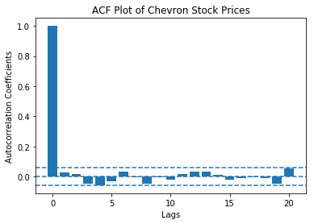
Auto correlation plot
The ACF plot determines the Moving Average(MA) term (q).
Defines the number of past forecast errors.
Value of q = number of lags that cross the significance level in the ACF plot.
This plot shows that value of q = 0.

Slide 13
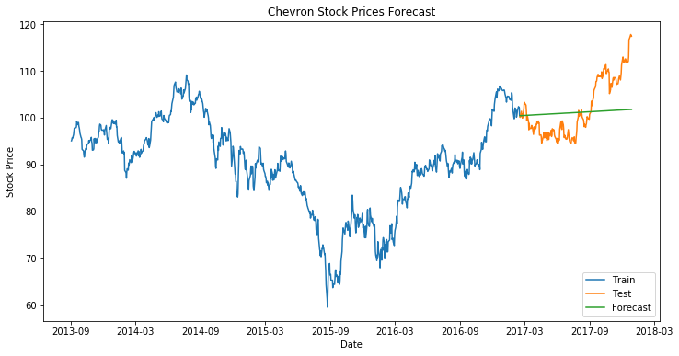
Forecasting
Stock prices were forecasted with the combination (p,d,q) = (0,1,0)
The model gave a Root Mean Squared Error of 5.92.

Slide 14
VAR model
https://github.com/RupaliShah/Springboard/blob/master/Capstone2/Stock%20Prediction%20with%20VAR.ipynb

Slide 15
What is VAR?
Vector Auto Regression.
Uses a multivariate Time Series to make predictions.
Each variable is a linear function of the past values of itself and of all the other variables.

Slide 16
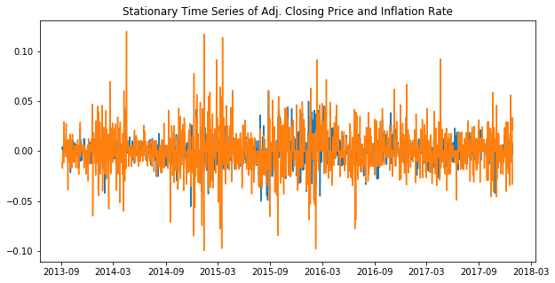
Stationary Series
Multivariate Series is checked for Stationarity based on Eigen values.
Stationarity check is done using the Coint Johansen test.
This plot shows the stationarized series after differencing the original Time Series (Adj. Closing Price and Inflation Rate) once.

Slide 17
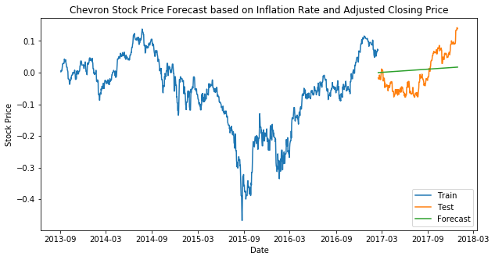
Forecasting
Number of lags are determined by the VAR model.
The model gave a Root Mean Squared Error of 0.0127.

Slide 18
LSTM model
https://github.com/RupaliShah/Springboard/blob/master/Capstone2/Stock%20Prediction%20with%20LSTM.ipynb

Slide 19
What is LSTM?
Long-short term memory.
Can make predictions on univariate as well as multivariate Time Series.
Takes a 3D array as an input.
Series is normalized in the range 0 to 1.

Slide 20

LSTM Architecture
Chain of repeating modules of Neural Networks.
The LSTM unit is composed of :
cell
input gate
output gate
forger gate
The cell remembers the values over arbitrary intervals of time.
The gates regulate information in and out of the cells.
Activation function of the LSTM gates is the Sigmoid function.

Slide 21
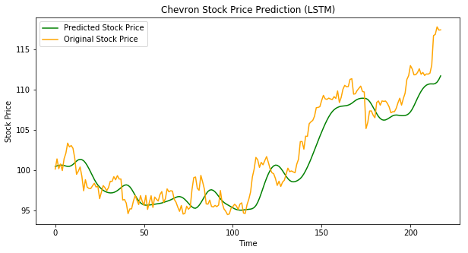
LSTM Forecast
Model was compiled with the ‘adam’ optimizer.
The model was trained for 24 epochs with a batch size of 32.
The model gave a Root Mean Squared Error of 2.37.

Slide 22
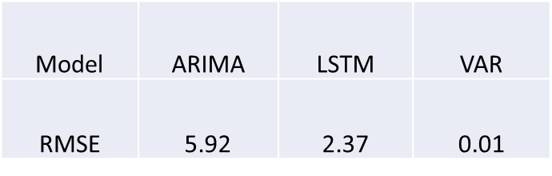
Result
ARIMA and VAR model predictions are not close to the real values.
The LSTM model prediction is close to the real data, though it does not predict the exact values.

Slide 23
Future Work
Train the VAR model with additional features such as Twitter Sentiment.
Train the LSTM model with multivariate data such as the Inflation Rate and Twitter Sentiment.

Slide 24
Thank You!

